Slide 1


Senior Design Project
Bovidae Framework – A easy way to build full-featured web applications
Supervised By: Ms. Sumera (Assistant Professor)

Slide 2
Project Team
Kainat Khalid (15178)
Asma Malik (20939)
Amna Shehzadee (15395)

Slide 3
Table of Content
Opportunity & Stakeholders
Solution
Progress Report Summary
Requirements
Software System (Design + Implementation + Testing)
Endeavour (Team + Work + Way of Working)
Next Steps
Prototype / Report

Slide 4
Opportunity & Stakeholders

Slide 5
Opportunity & Stakeholders
Opportunity:
PHP gives us– flexibility, ease-of-use, among others
PHP frameworks streamline the development of web applications written in PHP
Saves time
Help build more stable applications
Reduce the amount of repetitive coding for developers

Slide 6
Opportunity & Stakeholders
Opportunity:
But still we face a lot of problem working with PHP frameworks that are as follow:
Some not provide Version support
Some not provide multiple databases
Low Dependency Injection Container
Issues with Template Engine
Large Folder size
Not every framework provide User interface
Weaker ORM
Low Speed

Slide 7
Opportunity & Stakeholders
Opportunity:
In order to fix these issues we will proposed a system “Bovidae Framework”.
Bovidae will provide an opportunity to developer
New developer can easily create their website
Provide help of each type of developer.
Secure Platform

Slide 8
Opportunity & Stakeholders
Stakeholders:
Developer

Slide 9
Solution
We purpose a framework architecture “Bovidae Framework”
Bovidae framework have an ability to resolve all the problems discussed before.
On Bovidae framework, heavy or small budget web project can be develop

Slide 10
Solution
Bovidae framework will have following features:
Well Organized File Architecture
Session and Cookie Handling
Integration of Different Email Clients
Template Engine
Less file size
Less Code which speeds up your development
Cache management

Slide 11
Solution
Reduce occurrence of error
Security
Template engine.
Boot loader
Routing
It also have ORM which allows us to represent or map relational database and generate SQL statements

Slide 12
PROGRESS REPORT Summary

Slide 13
REQUIREMENTS

Slide 14
Elicitation Techniques / Tools

Slide 15
Requirements
Elicitation Techniques / Tools
Interviews
Market/Literature Survey
Wire Framing / Prototyping

Slide 16
Market/Literature Survey

Slide 17
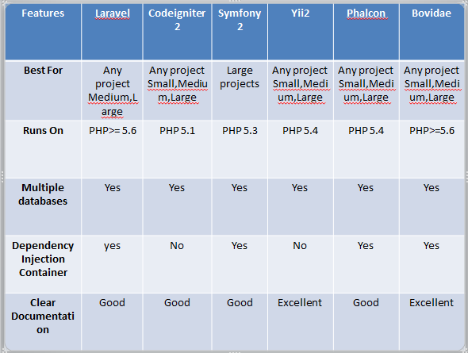

Slide 18
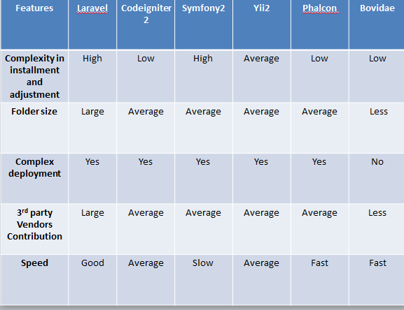

Slide 19
Wire Framing

Slide 20
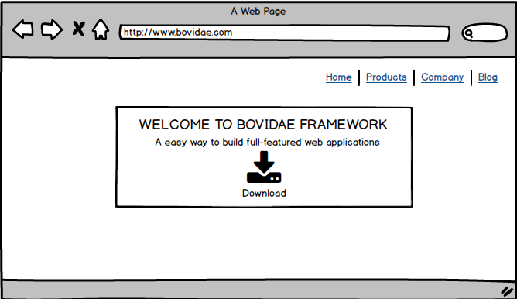
Main home Page

Slide 21
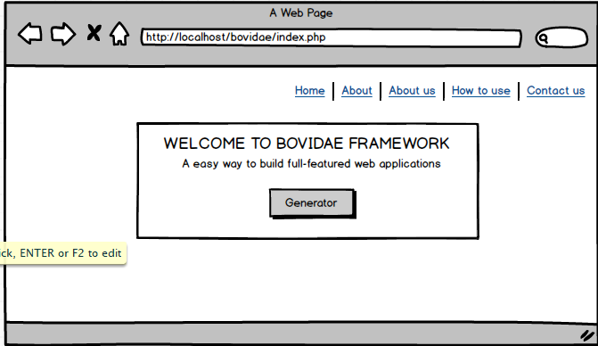
Development Page

Slide 22
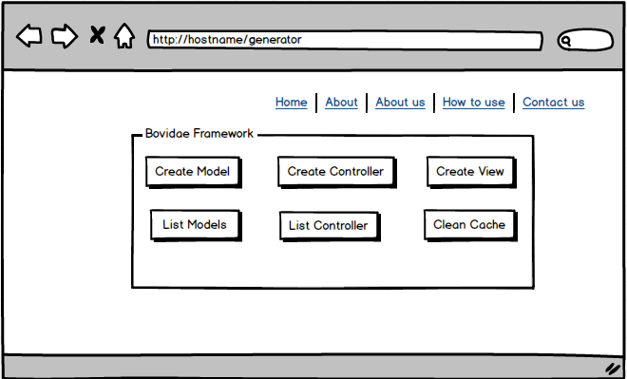
Generator

Slide 23
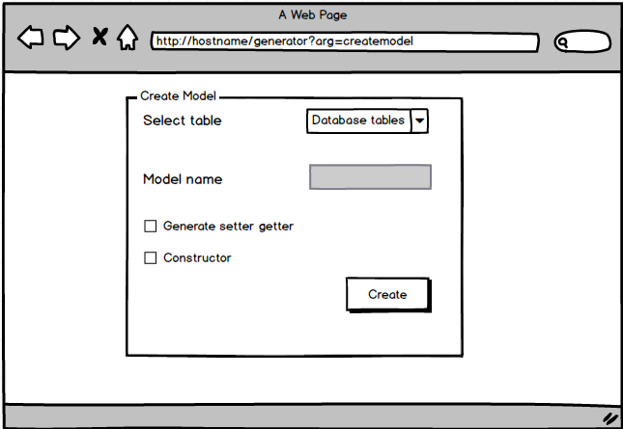
Create Model

Slide 24
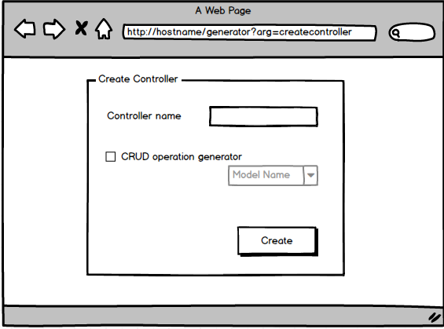
Create Controller

Slide 25
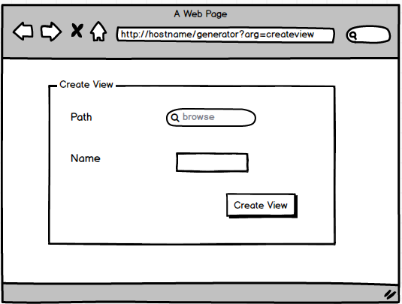
Create View

Slide 26
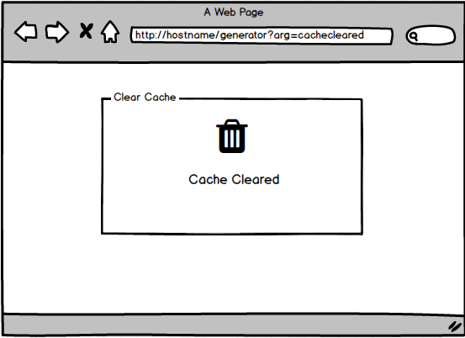
Clear Cache

Slide 27
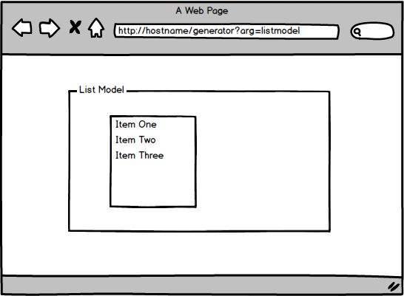
List All Models

Slide 28
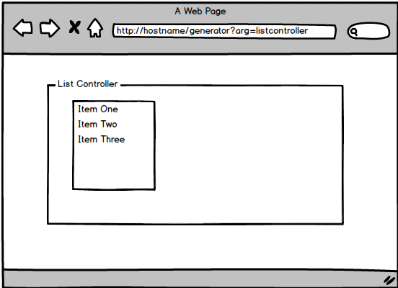
List All Controller

Slide 29
Specification / Documentation

Slide 30
Requirements
Specification / Documentation
List of Stakeholders
Developer

Slide 31
Requirements
Use Cases(17)
Functional Requirements(16)
Non Functional Requirements(4)

Slide 32
Use Cases

Slide 33
Use Cases
Create Model
Manage Model
Add Attributes
Create Controller
Add Methods
Render View
Clear Cache
View All Controller
Include External Libraries
10. Include Model
11. Create View
12. Process Variable
13. Create Layout
14. Include External View
15. View All Model
16. Configure Framework
Environment
17. Setup Database

Slide 34
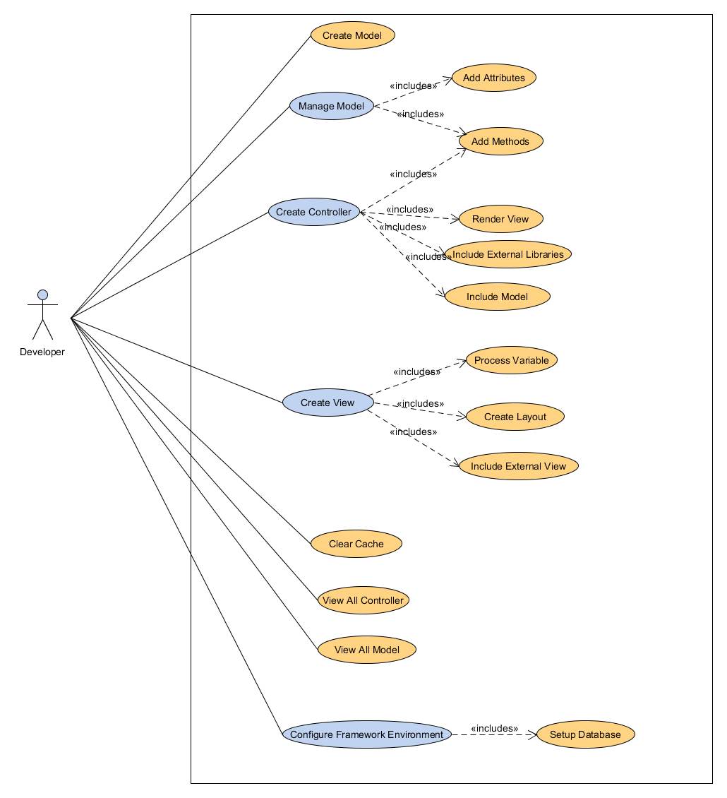

Slide 35
Functional Requirements

Slide 36
FR-# | Functional Requirements | Priority
[FR-1] | Developer shall be able to create a Model. | High
[FR-2] | Developer shall be able to create controller. | High
[FR-3] | Developer shall be able to create view. | High
[FR-4] | Developer shall be able to Add Attributes. | Medium
[FR-5] | Developer shall be able to Add Methods. | Medium
[FR-6] | Developer shall be able to manage model. | High
[FR-7] | Developer shall be able to include external libraries. | Medium
[FR-8] | Developer shall be able to include models. | High

Slide 37
FR-# | Functional Requirements | Priority
[FR-9] | Developer shall be able to render view. | Medium
[FR-10] | Developer shall be able to create layouts. | Low
[FR-11] | Developer shall be able to set database. | High
[FR-12] | Developer shall be able to clear cache. | High
[FR-13] | Developer shall be able to view all model. | Medium
[FR-14] | Developer shall be able to view all controllers. | Medium
[FR-15] | Developer shall be able to configure framework environment. | High
[FR-16] | Developer shall be able to create external view. | Medium

Slide 38
Non-FUNCTIONAL REQUIRMENTS

Slide 39
Non Functional Requirements
NFR-# | Non-Functional Requirements
[NFR-1] | Usability
[NFR-2] | Availability
[NFR–3] | Efficiency
[NFR–4] | Support

Slide 40
Design

Slide 41
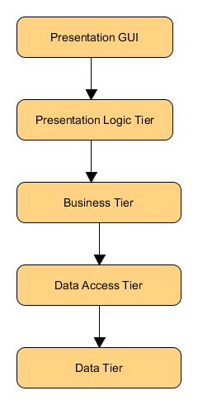
Architectural Design

Slide 42
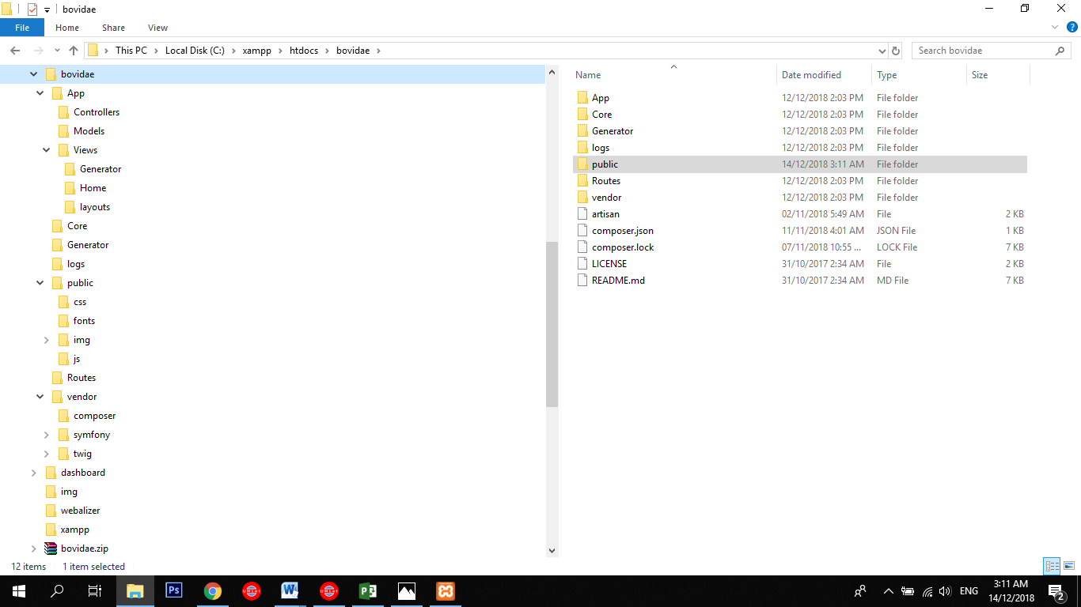
Bovidae Framework Directory

Slide 43
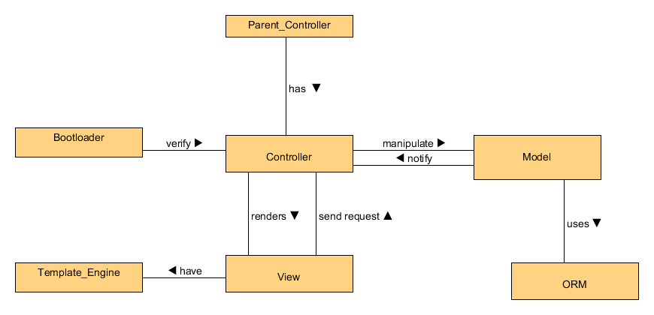
Domain Model

Slide 44
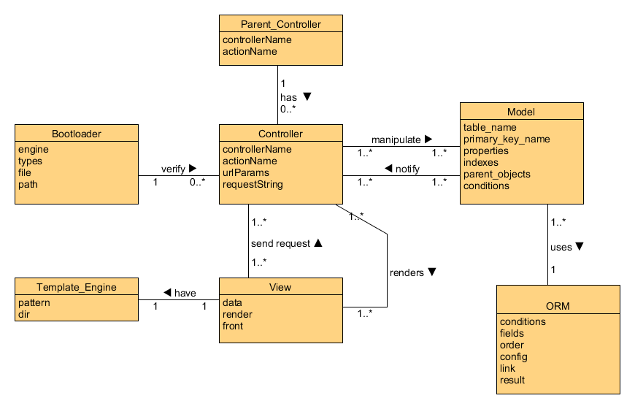
Entity Relationship Diagram(ERD)

Slide 45
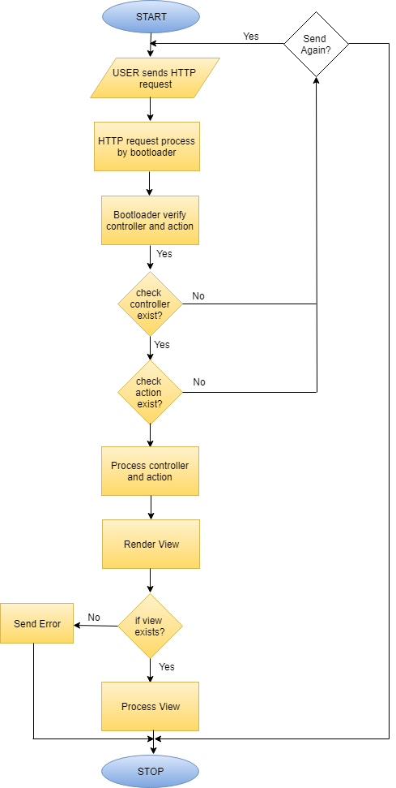
Processing Request

Slide 46
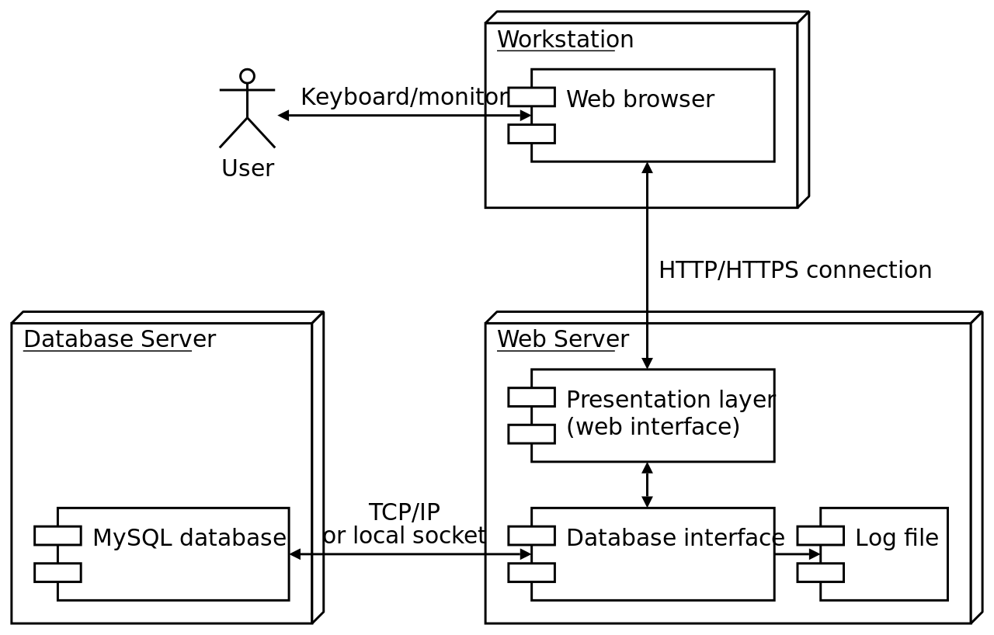
Deployment Diagram

Slide 47
Implementation

Slide 48
Implementation
List Development Tools & Technologies
List Best Practices / Coding Standards
List Libraries / Components / Web Services

Slide 49
Development Tools & Technologies
The technologies used for this project are:
HTML5
CSS3
PHP
JavaScript
JQuery
Bootstrap
Ajax
MySQL
WAMP/XAMPP
UMLET
Sublime text 3
Notepad++
VISIO
Astah

Slide 50
Best Practices / Coding Standards
The following conventions are followed:
Naming convention
Pages: All in lowercase with dashed separators.
Variable: Follow camel case.
Class names MUST be declared in StudlyCaps
Class constants MUST be declared in all upper case with underscore separators.
Method names MUST be declared in camelCase.

Slide 51
Libraries / Components / Web Services
Component in software development is a generic term which can be used purposely according to the software being developing. Components sometimes refer to the hardware components that are required by the software being developing and can also stand for the software components required. We can think of a component as the subset of a module or in other words one module can have multiple components inside it

Slide 52
Testing
Black Box Testing
Test Case Scenarios
TC-# | TEST CASES
[TC- 1] | Create Model
[TC- 2] | Create Controller
[TC- 3] | Create View
[TC- 4] | Clear Cache
[TC- 5] | View All Model
[TC- 6] | View All Controller
[TC- 7] | Setup Database
[TC- 8] | Add Methods
[TC- 9] | Render View
[TC- 10] | Include external libraries
[TC- 11] | Create layouts
[TC- 12] | Include external view

Slide 53
Conclusion & Outlook

Slide 54
Conclusion & Outlook
Bovidae Framework is an open-source framework for developing web applications, using object-oriented code.
Bovidae built for PHP coders
Its goal is to enable you to develop projects much faster than you could.
The main idea behind this project is to give relief to PHP developers and give a framework with less file size. It will give a platform to developers who face a lot of problems while working on projects.

Slide 55
Endeavour

Slide 56
Endeavour
Describe roles of your team members
Describe your software development process
Describe your way of working as a team

Slide 57
Team
No. | Group Members
1 | Kainat Khalid
2 | Asma Malik
3 | Amna Shehzadee

Slide 58
Work
No. | Bovidae Work
1 | Documentation
1.1 | Proposal
1.2 | Literature / Market Survey
1.3 | Requirement Analysis
1.3.1 | Functional Requirements
1.3.2 | Non Functional Requirements
1.4 | System Design
1.4.1 | Architectural Design
No. | Bovidae Work
1.4.2 | Detailed Design
1.4.3 | Domain Model
1.4.4 | Deployment Diagram
1.4.5 | Entity Relationship diagram
1.5 | Implementation
1.5.1 | Flow Control/Pseudo codes
1.5.2 | Components, Libraries, Web Services and stubs
1.5.3 | Deployment Environment
1.6 | Testing and Evaluation
1.6.1 | List of Test Scenarios
1.7 | Conclusion and Outlook
1.7.1 | Critical Review
No. | Bovidae Work
1.7.2 | Future Recommendations/Outlook
2 | Development Environment
2.1 | IDE
2.2 | Server
2.3 | Database
3 | MVC
3.1 | Views
3.1.1 | Generator
3.1.2 | Home
3.1.3 | layouts

Slide 59
Work
No. | Bovidae Work
3.1.4 | Additonal Pages
3.2 | Controllers
3.2.1 | GeneratorController
3.2.2 | Home
3.3 | Model
3.3.1 | Generator
4 | Core
4.1 | BovidaeORM
4.2 | Controller
4.3 | Error
No. | Bovidae Work
4.4 | Model
4.5 | Route
4.6 | View
5 | Public
5.1 | Index
5.1 | .htaccess

Slide 60
Way of Working
No. | Way of Work
1 | For writing Documentation: Microsoft Word Different tools for designing UML diagrams that are as follows: Umlet Creatly astah
2 | Work breakdown structure (WBS) of Bovidae Framework: Microsoft Project
3 | Different servers for creating our system: Xampp WampServer
4 | Different PHP Software for writing our code: Brackets Sublime Text 3 Notepad++

Slide 61
Way of Working
No. | Way of Work
5 | Database: mySQL
6 | PHP version: =>5.6
7 | Tool for team collaboration: Microsoft project Team viewer Google Drive Skype Whatsapp
8 | Task Allocation: We create to do list and define task to each member of team.
9 | Distributed version control and source code management functionality: Github
10 | For promotion: Faceboo page Youtube Channel Github account Twitter Account

Slide 62
NEXT STEPS

Slide 63
Work Breakdown Structure

Slide 64
Work Breakdown Structure (List of all Deliverables / Strikethrough Completed Deliverables)
Views
Generator
Home
layouts
Controllers
GeneratorController
Home
Views
Generator
Core
BovidaeORM
Controller
Error
Model
Route
View
Public
Index
.htaccess

Slide 65
Work Breakdown Structure (List of all Deliverables / Strikethrough Completed Deliverables)
Requirement Analysis
Functional Requirements
Non Functional Requirements
System Design
Architectural Design
Detailed Design
Domain Model
Deployment Diagram
Entity Relationship diagram
Implementation
Flow Control
Endeavour
Testing and Evaluation
List of Test Scenarios
Conclusion and Outlook
Critical Review
Future Recommendations/Outlook

Slide 66
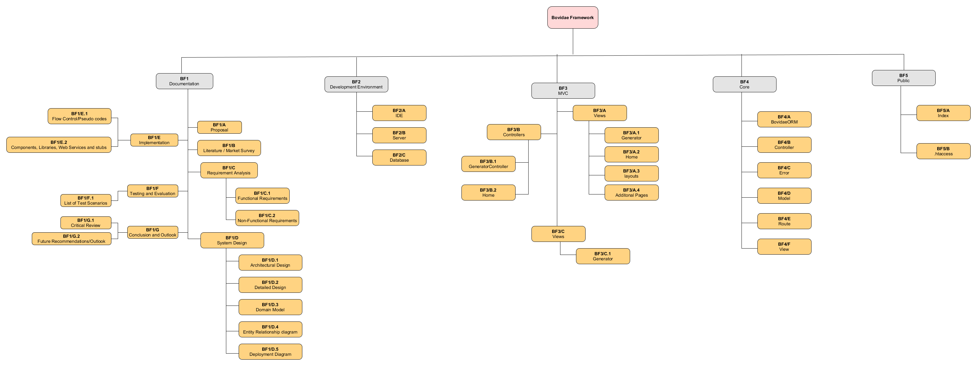

Slide 67
Challenges
PHP is the top choice for web developers. It’s so popular that currently it powers more than 80% of websites. Websites like Facebook, Yahoo, Flickr, Wikipedia are developed using PHP.
One of the biggest challenges for developers is to build a high-quality website or application quickly. And most web applications require common repetitive tasks. Using PHP frameworks is a great solution to ease and accelerate development. Frameworks include different methodologies, security policies, and reusable parts of code.
Frameworks are useful when creating complex projects, as developers don’t have to start from nothing each time. Frameworks provide organized and reusable code and allow you to scale projects easily.

Slide 68
Prototype & Report

Slide 69
Branding

Slide 70

Logo

Slide 71
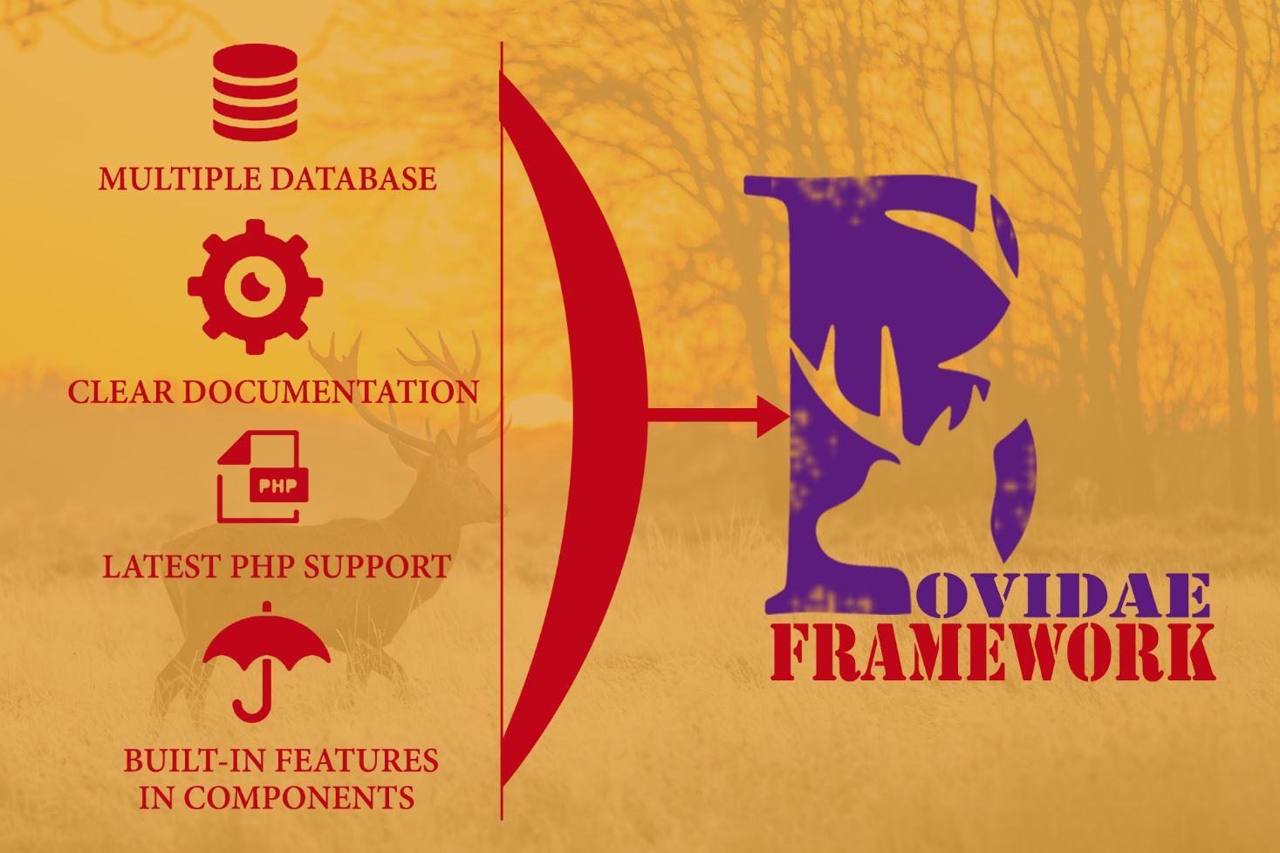
Banner

Slide 72
Prototype

Slide 73
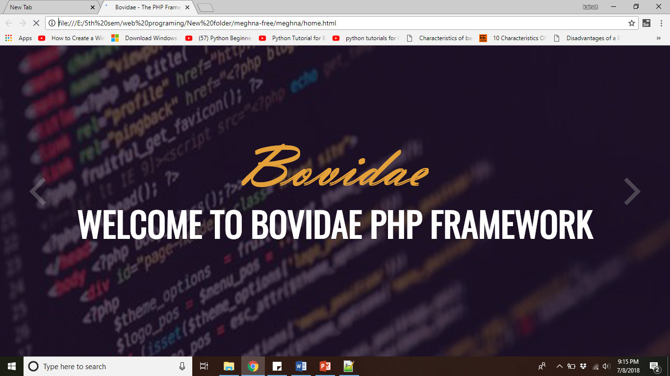
Home

Slide 74
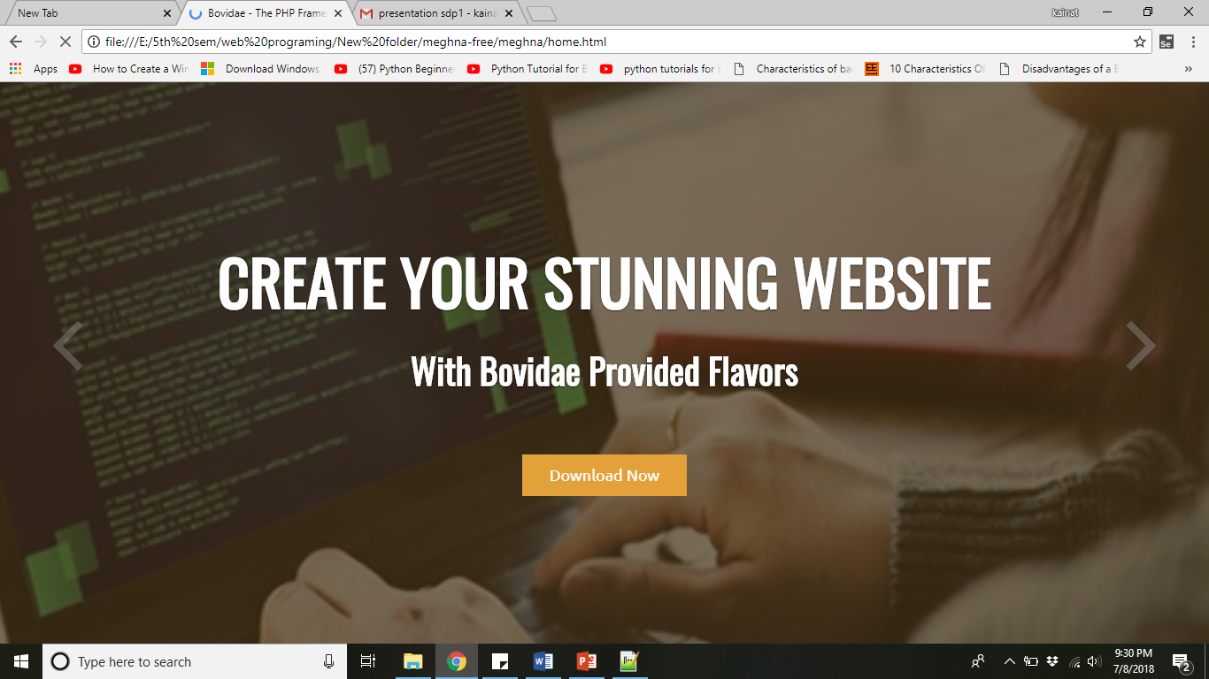
Home

Slide 75
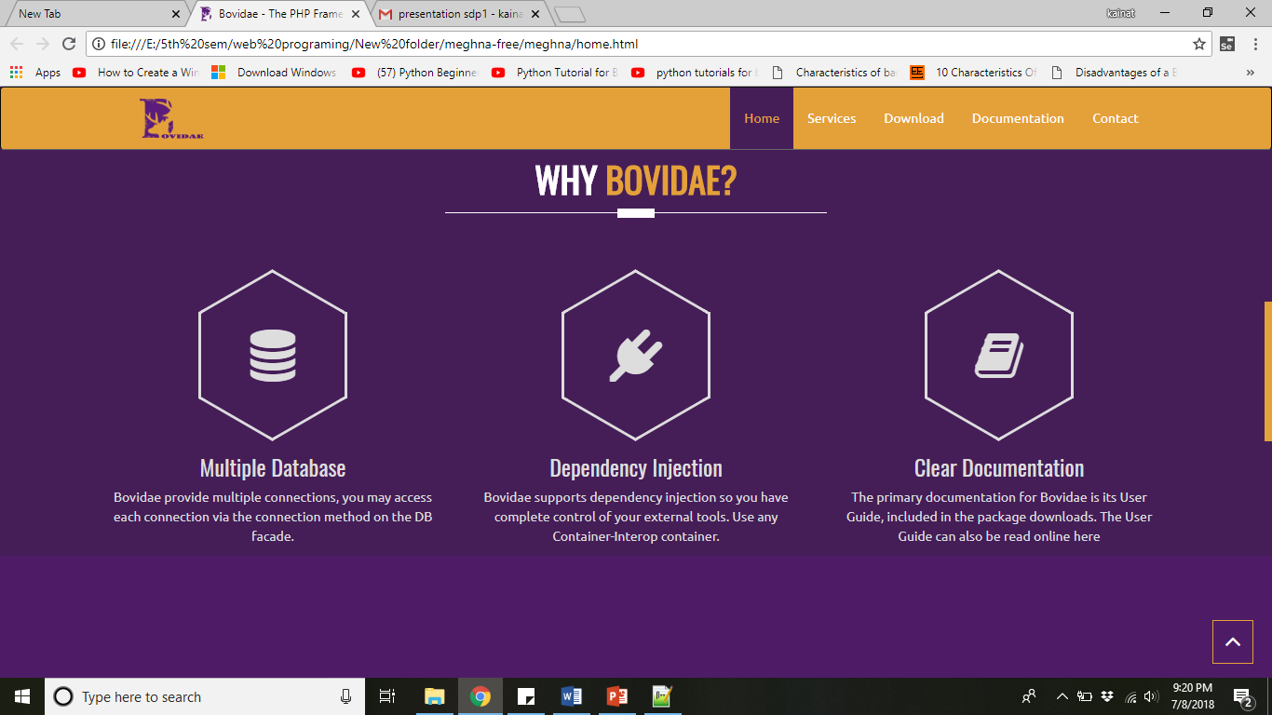
Home

Slide 76
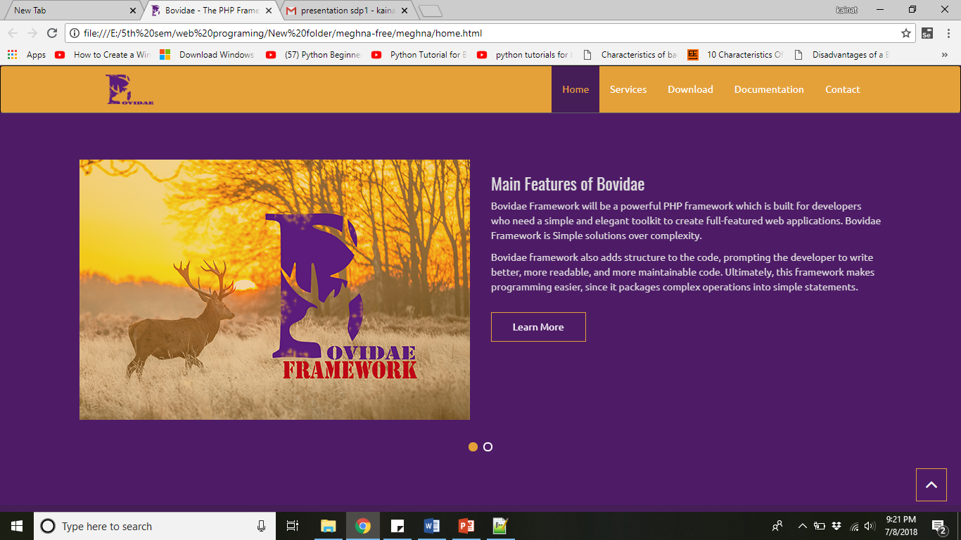
Home

Slide 77
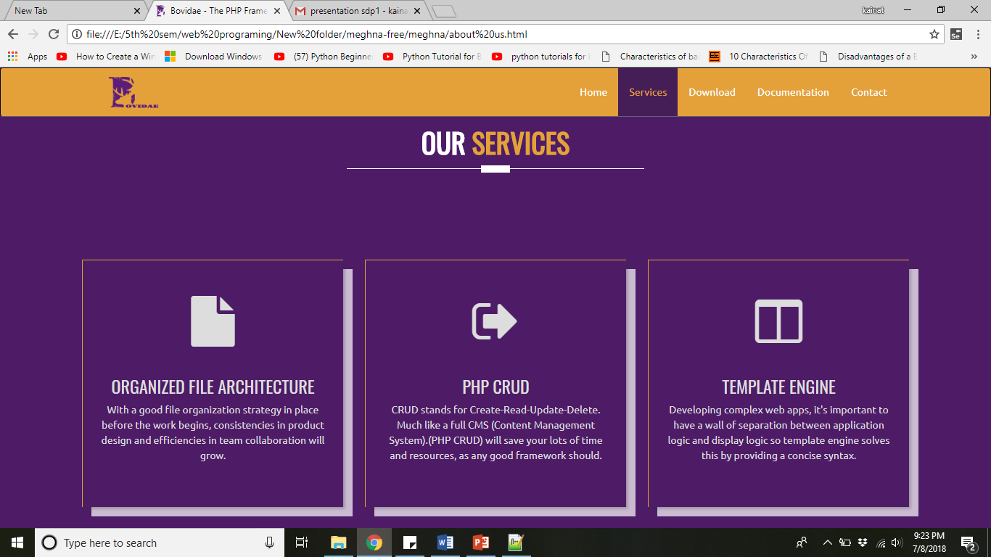
Services

Slide 78
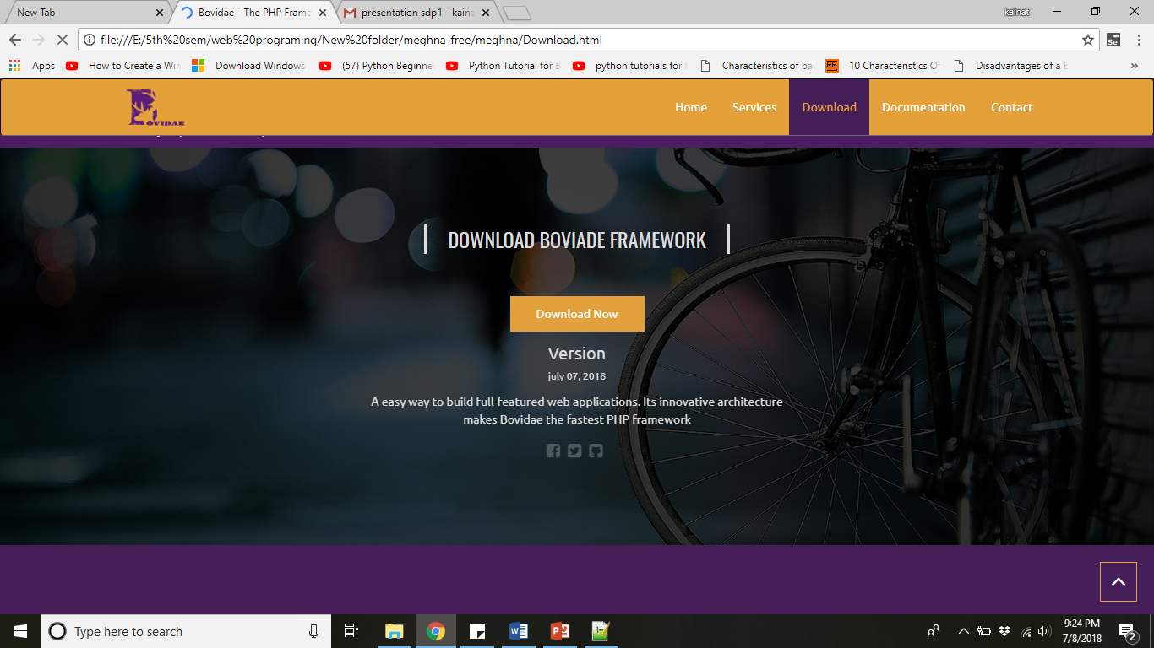
Download

Slide 79
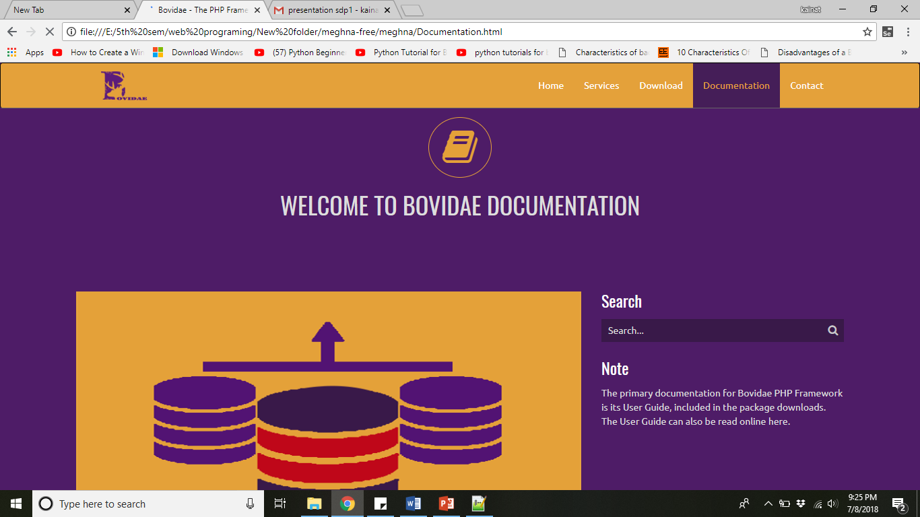
Documentation

Slide 80
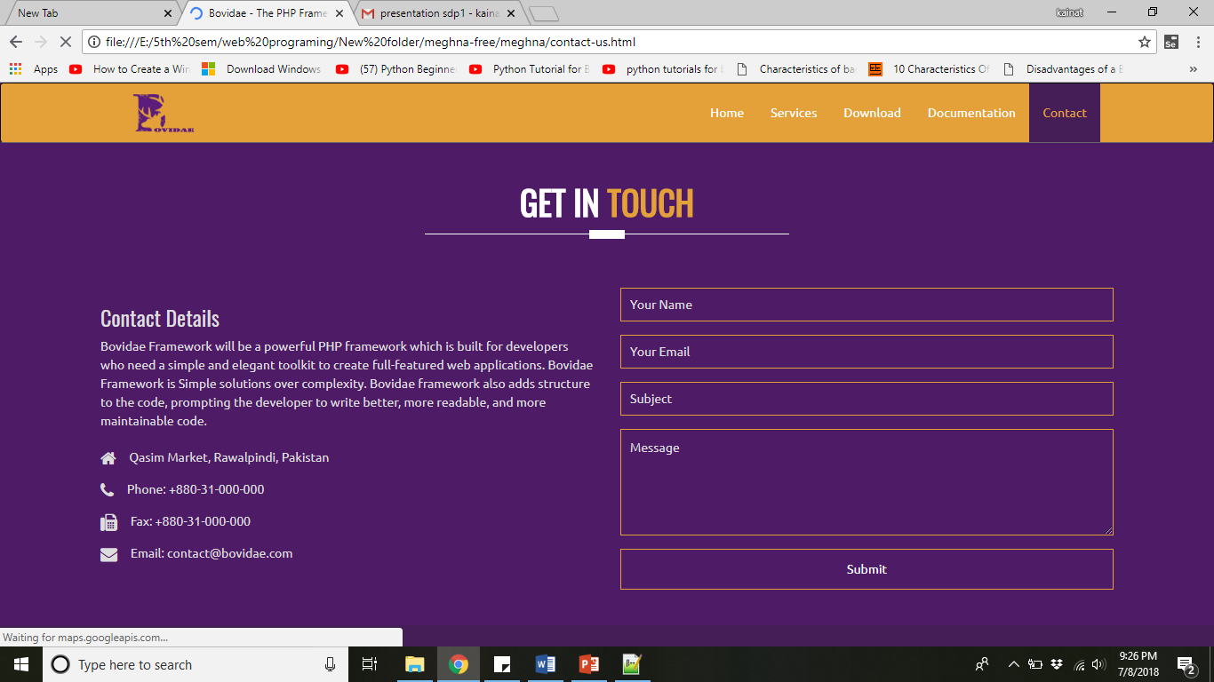
Contact Us

Slide 81
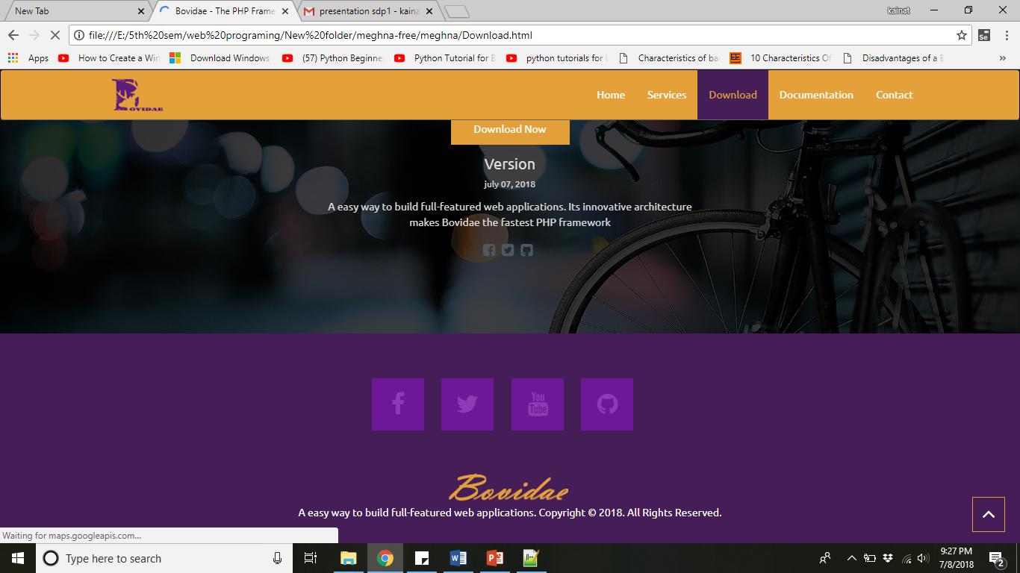
Footer

Slide 82
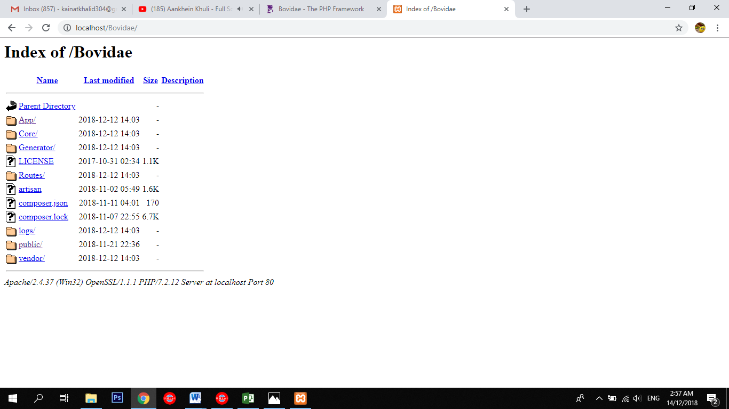
Framework View

Slide 83
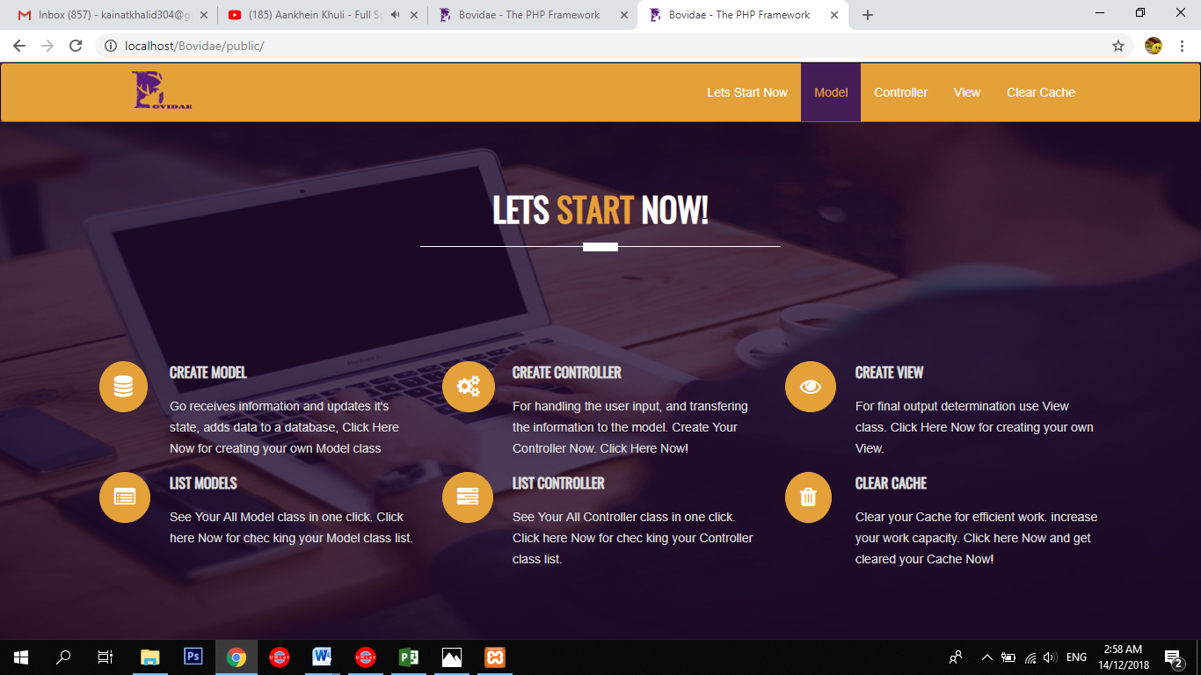

Slide 84
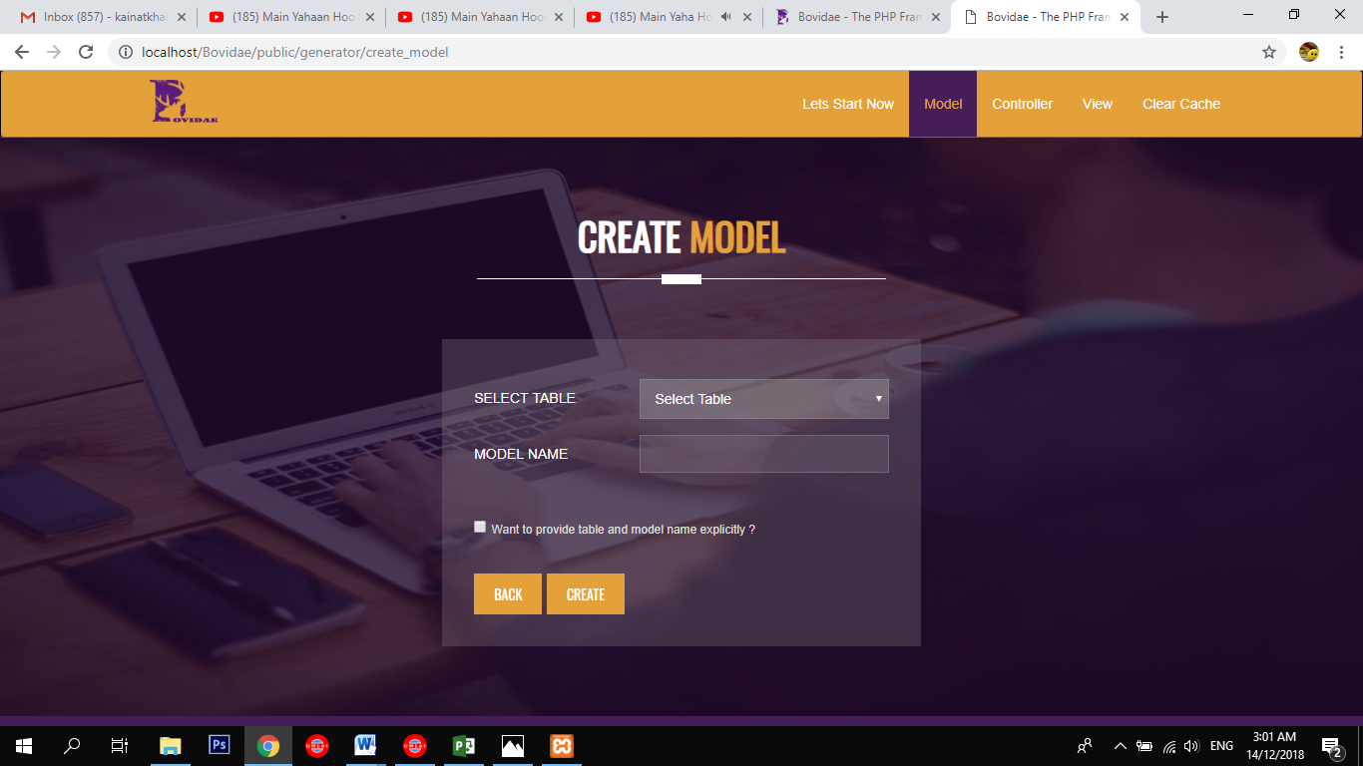

Slide 85
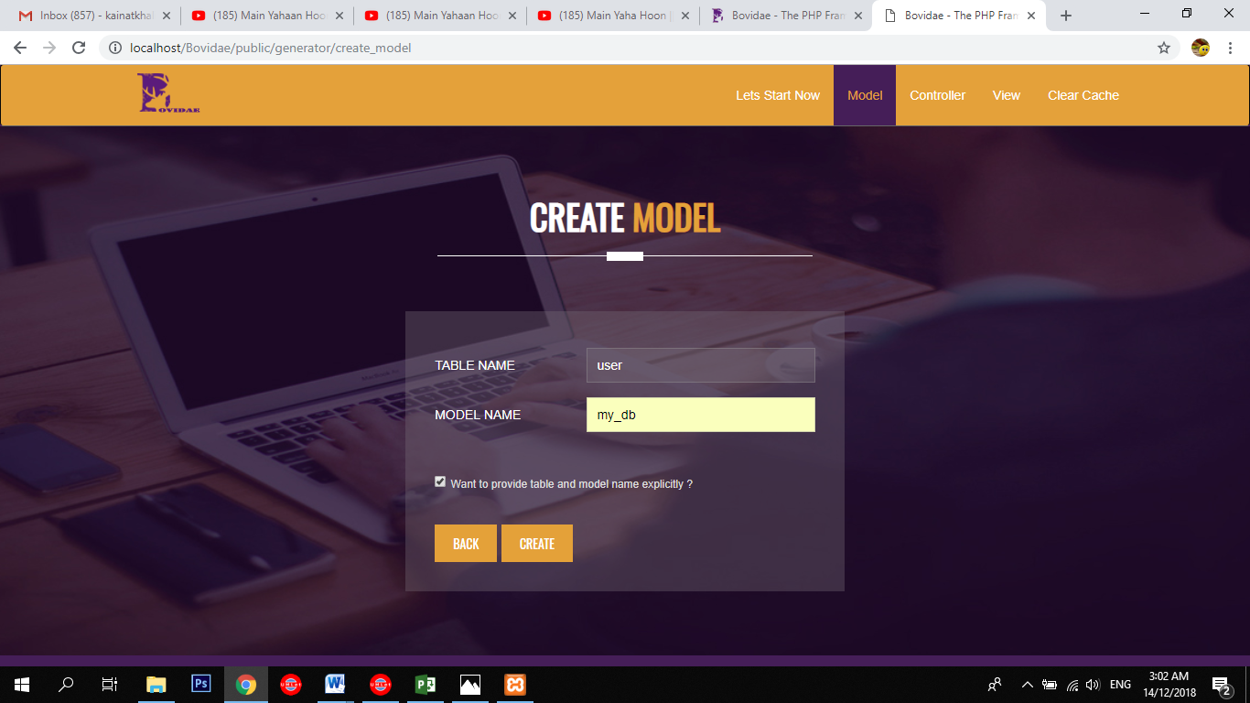

Slide 86
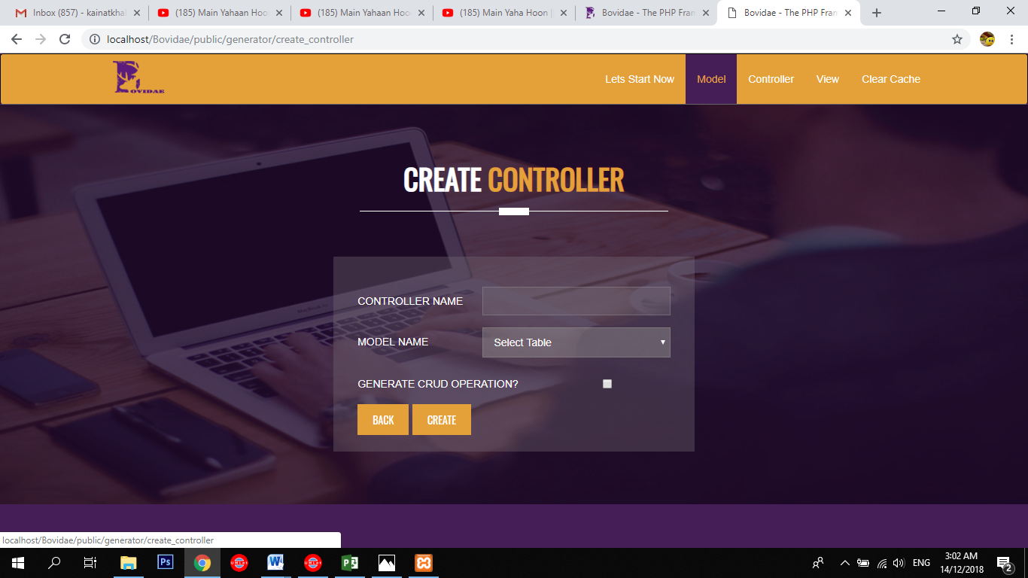

Slide 87
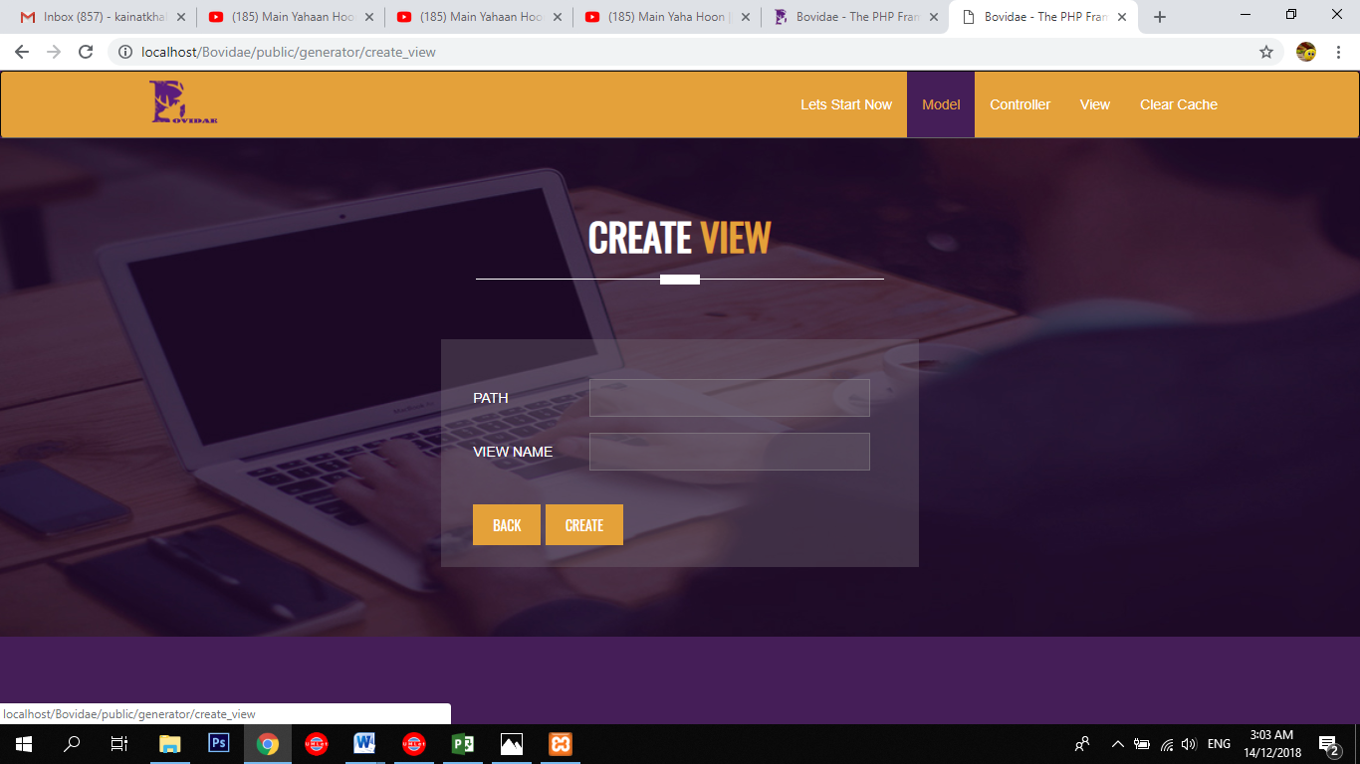

Slide 88
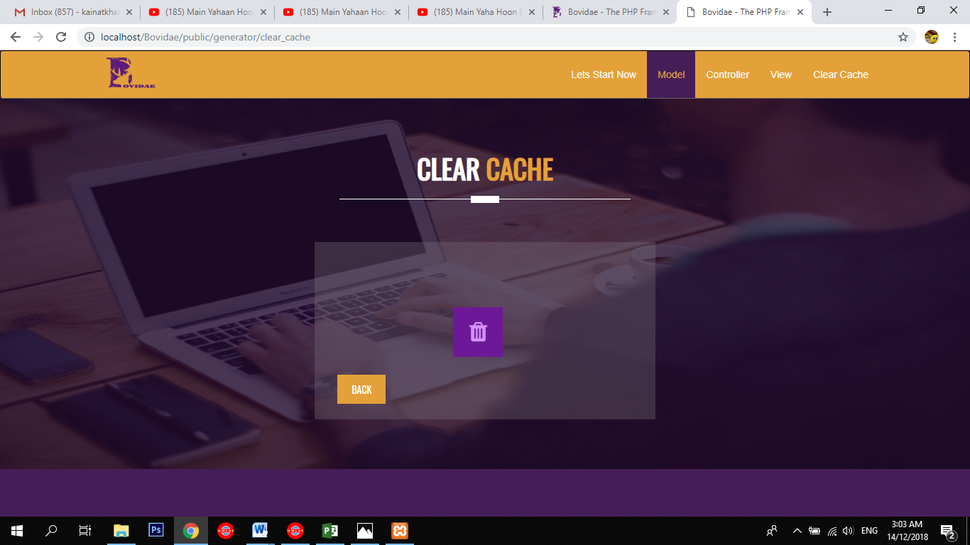

Slide 89
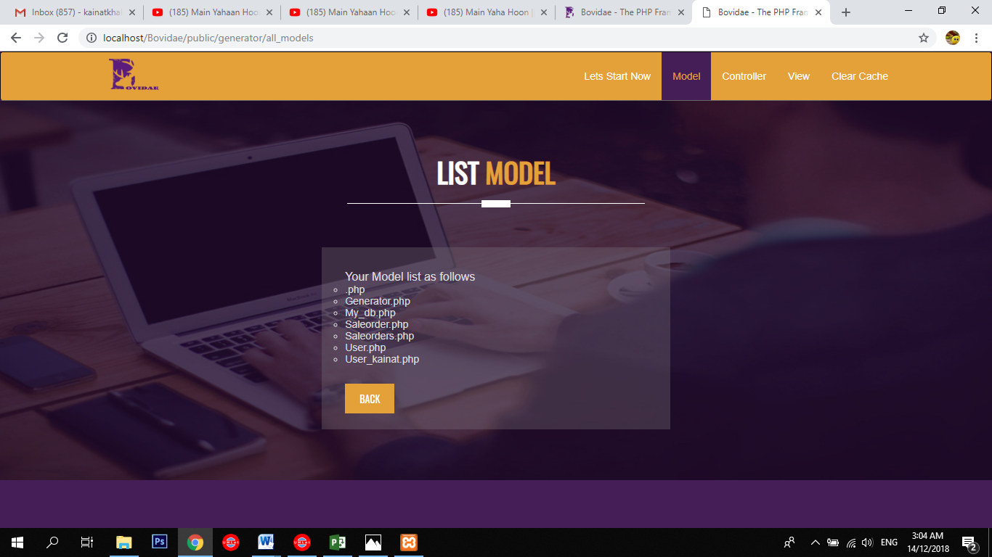

Slide 90
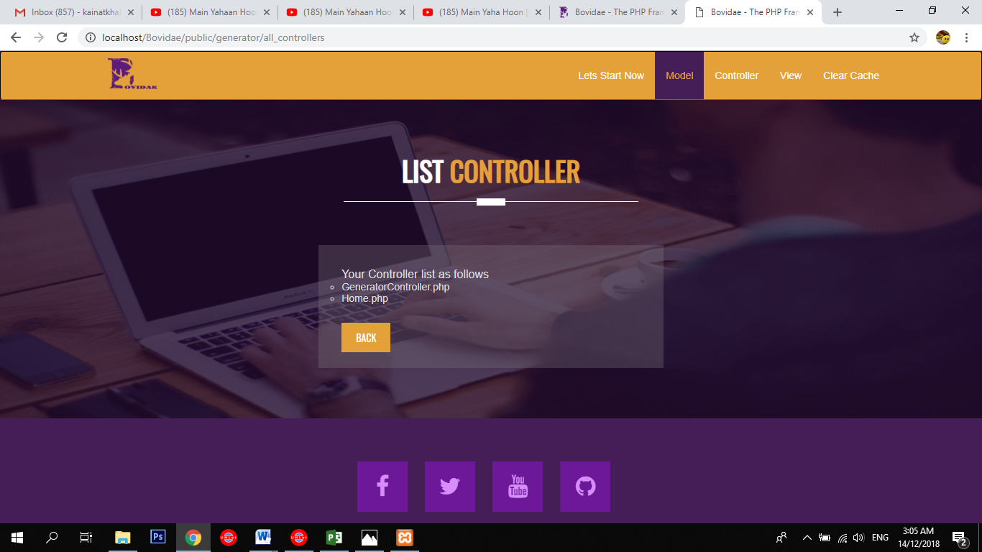

Slide 91
Report
Chapter 1: Introduction
Chapter 2: Literature / Market Survey
Chapter 3: Requirement Analysis
Chapter 4: System Design
Chapter 5: Implementation
Chapter 6: Testing & Evaluations
Chapter 7: Conclusion & Outlook

